Slide 1
An Interactive Analysis of Suicide Trends in Greece, 2011-2015
Tragakis Iasonas

Slide 2


Data
Our analysis will rely on datasets from Eurostat and the World Health Organization (WHO) for the period 2011 - 2015.
In our analysis we will mainly use sucide rates of a population adjusted to a standard age distribution and calculated on the basis of a standard European population (defined by the World Health Organization). Absolutes numbers or even not adjusted rates are proportional to the population size, so the bigger the population the more the suicides.
Also as most causes of suicide vary significantly with people's age and sex, the use of standardised suicide rates improves comparability over time and between countries as they aim at measuring suicide rates independently of different demographic compositions. Finally in terms of reproducibility of our analysis it worth mentioning that Eurostat and the World Health Organization (WHO) have stopped providing absolute suicide numbers. We will only use absolute suicide numbers for comparisons between age groups and sex in Greece, in order to backup part of our analysis.

Slide 3
Per Country
The following interactive dashboard is made with R and library Shiny. The drop-down list on the left can be used to filter the country. For this country 4 plots are created, 1 showing the total suicide rate trend, 2 showing the suicide rate trends for male and female and finally 1 comparing male and female suicide rates.

Slide 4
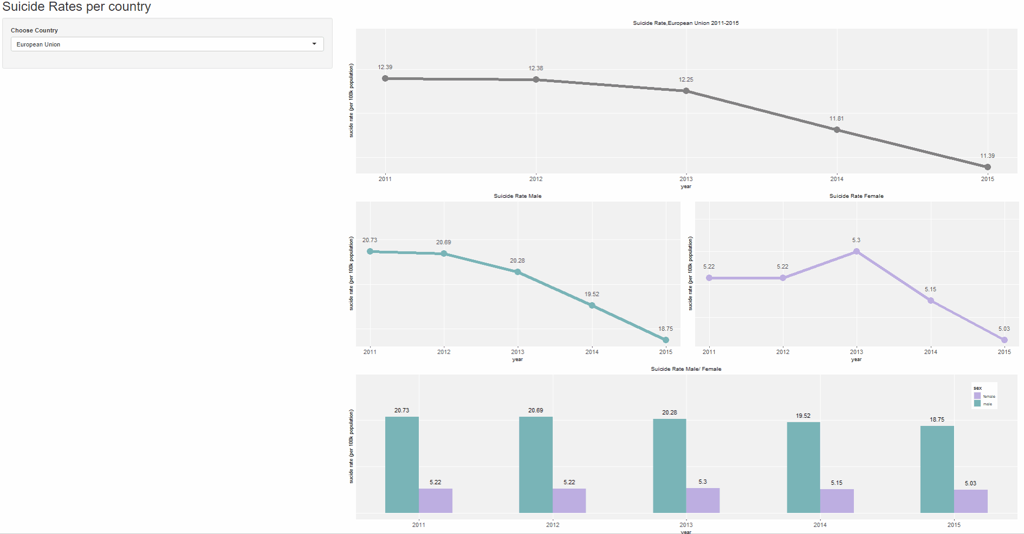
Per Country

Slide 5
Compare Greece
The following interactive dashboard is made with Tableau. The horizontal barchart on the left can be used to inspect the position of Greece among other countries of the EU (Also the EU as a single entity) by using average suicide rates for the period 2011-2015. By clicking a country on the left horizontal barchart, the right bottom line chart is filtered to allow a comparison between the selected country and Greece.
The purpose of this dashboard is to give as the capability to compare Greece with other countries by trend or even absolute rates by inspecting the y scale, in a simplified way. In the same time it gives us a reference of Greece general position in the EU.

Slide 6
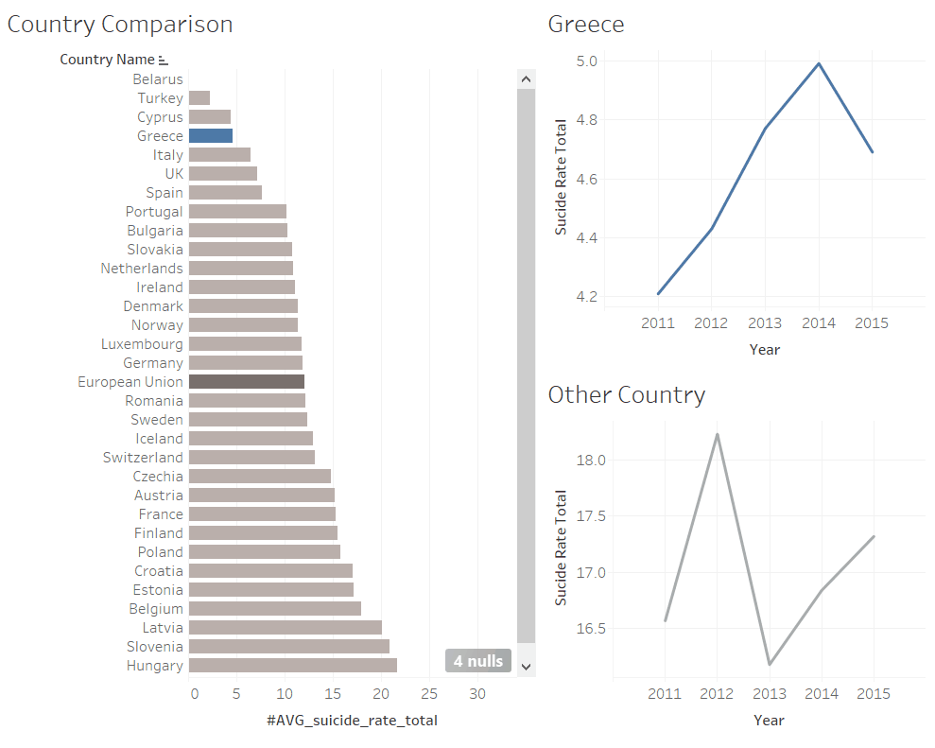
Compare Greece

Slide 7
Compare Years
This following interactive dashboard is made with Tableau. The purpose of this graph is to easily compare the change of suicide rate in two different years (a base year and a selected year), among the countries of the EU. At the top we have 2 parameter filters where we can select the base year and the selected year. On the horizontal barchart on the left, we can inspect the change that occurred in absolute values. Green (Red) color indicates that the suicide rates have decreased (Increased) from the base year. On the right scatter plot we can inspect that the Green (Red) color countries are above (bellow) the line. Theoretically countries on the line, had zero change in suicide rates between base and selected year.

Slide 8
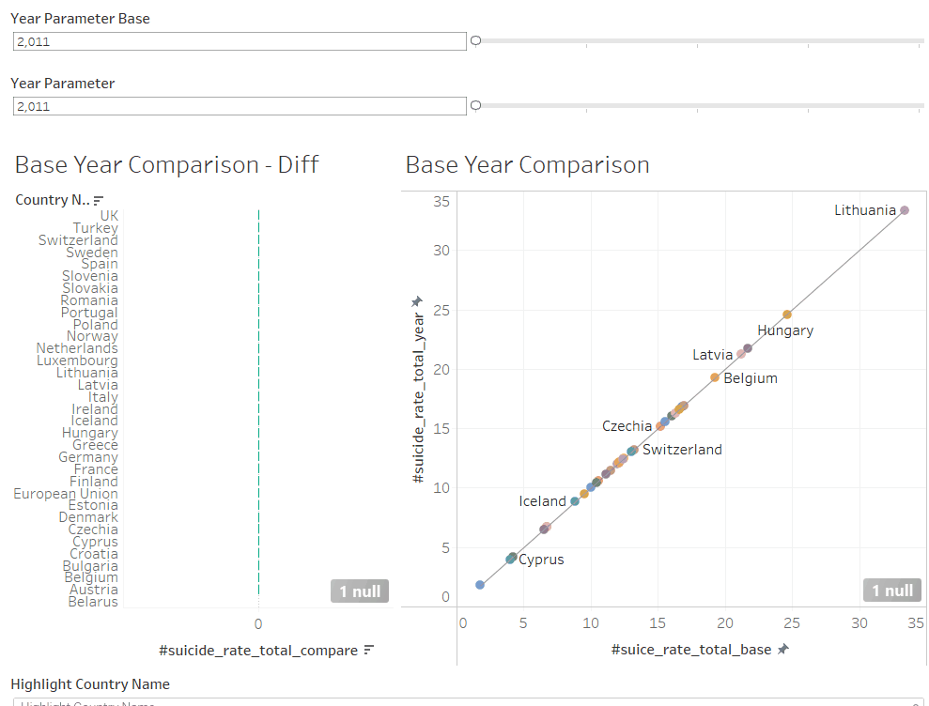
Compare Years

Slide 9
Map - Timelapse
The following interactive dashboard is made with Tableau. The purpose of this dashboard is to have a map to inspect different trends of suicide rates based on location (i.e coastal countries, specifically mediterranean countries show lower rates that the others) during the period 2011-2015. On the right we have also included a horizontal barchart for a better view of the position as well as the change in suicide rates during the years. For this specific graph we have manually selected the bins, using as a center the average suicide rates of the EU.

Slide 10
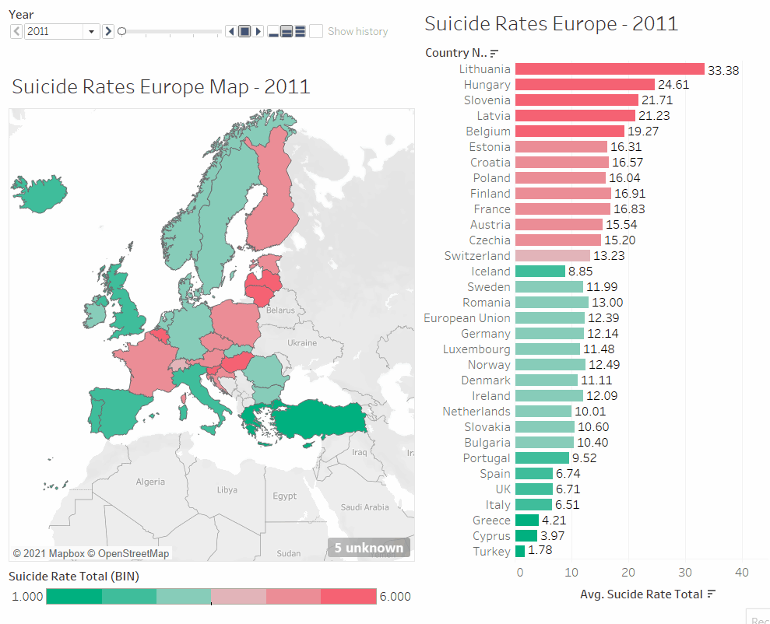

Slide 11
Suicide No
This following interactive dashboard is made with Tableau. The top horizontal barchart give us the position of Greece among the other countries of the selected group, in absolute values. The Country Name filter can be used to select a group. After selecting a group we have the capability to inspect this group’s suicides by age and sex, in the two bottom charts. We can also select a single country from the group by clicking on the top horizontal barchart to filter suicides by age and sex for that specific case.
The purpose of the dashboard is to give us a increased functionality using the filters to inspect suicides per country, age and sex.

Slide 12
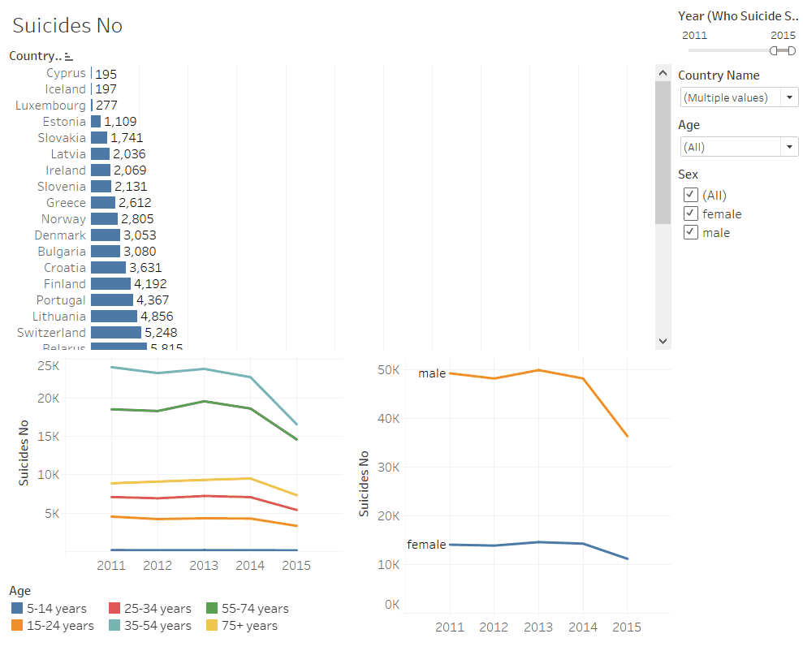
Suicide No

